Slide 1
IBM University Engagement Project Submission
“Exploring the Power of Agentic AI with IBM Granite and IBM Bob”

Slide 2
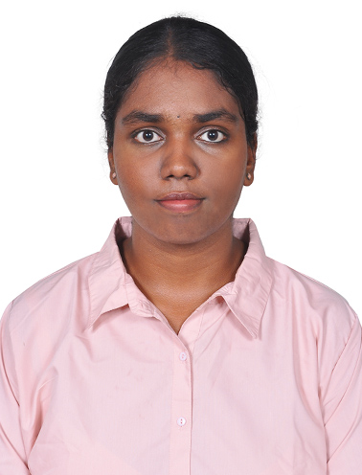
Project Tile - NutriGuide AI – Personalized AI Nutrition Assistant
Domain of Project – Healthcare
Student Name | Recent Passport Photo | Email ID | Mobile number [WhatsApp]
SUCHITHRA S |  | suchithra.s.work@gmail.com | 8667059065

Slide 3
Problem Statement -
Problem Statement – Nutrition Agent
Problem
People often struggle with personalized nutrition guidance, diet planning, portion control and nutrition tracking.
Generic nutrition advice does not always consider an individual's age, preferences, lifestyle and goals.
Users need an intelligent system that can provide personalized and practical nutrition guidance.
Challenge
Personalized nutrition guidance is difficult because individuals have different dietary preferences, nutritional needs, health goals and eating habits. Users need support for diet planning, portion control and nutrition tracking.
Objective
Develop an AI-powered personalized Nutrition Agent for diet planning and nutrition guidance.
Provide personalized diet plans based on user requirements.
Implement Food Data RAG for retrieving relevant nutrition information.
Enable diet tracking and feedback based on logged food.
Provide preventive health guidance related to nutrition and wellness.
Build a multi-agent system consisting of:
  Nutrition Knowledge Agent
  Diet Recommendation Agent
  Health Advisory Agent
  Food Log & Feedback Agent
Provide a visualization dashboard for nutrition tracking and insights.

Slide 4
Proposed Solution -
Proposed Solution – AI-Powered Nutrition Agent
NutriGuide AI is a multi-agent AI-powered nutrition guidance application built using IBM Bob, IBM watsonx.ai and IBM Granite to provide personalized nutrition support.
The system addresses challenges in diet planning, nutrition tracking, food recommendations and preventive health guidance through a modular agent-based architecture.
At its core, the solution uses Retrieval-Augmented Generation (RAG) to retrieve relevant nutrition information from a local food dataset and provide contextual responses using IBM Granite.
The system consists of four key agents:
Nutrition Knowledge Agent – retrieves relevant food and nutrition information using RAG.
Diet Recommendation Agent – generates personalized one-day meal plans and healthy food recommendations based on user profile and goals.
Health Advisory Agent – provides general preventive health and nutrition guidance with an appropriate wellness disclaimer.
Food Log & Feedback Agent – analyzes logged food entries and provides nutritional feedback including calories and macronutrients.
The solution also includes a user-friendly dashboard that visualizes daily calorie intake, calorie goals and macronutrient information.
IBM Bob was used to assist in developing and organizing the application, while IBM watsonx.ai provides the IBM Granite model inference environment. Granite powers AI-generated nutrition guidance, reasoning and personalization.
Overall, NutriGuide AI provides an end-to-end personalized nutrition guidance experience combining RAG, multi-agent AI, food tracking, recommendations and visualization.

Slide 5
Technology Used
IBM Bob – For AI-assisted project development, implementation, debugging and workflow support.
IBM Granite – For natural language understanding, reasoning, summarization and personalized nutrition responses.
IBM Cloud – Provides the cloud infrastructure and services used for the NutriGuide AI application.
IBM watsonx.ai / Watson Machine Learning Runtime – For IBM Granite model inference and AI platform integration.
RAG (Retrieval-Augmented Generation) – Retrieves relevant nutrition information from the project's food dataset and provides it as context for AI responses.
Node.js & Express – For developing the backend server and API endpoints connecting the application with the AI agents.
HTML, CSS & JavaScript – For building the interactive NutriGuide AI web interface.
Chart.js & Local Storage – For nutrition dashboard visualization and maintaining the user's food-log data.

Slide 6
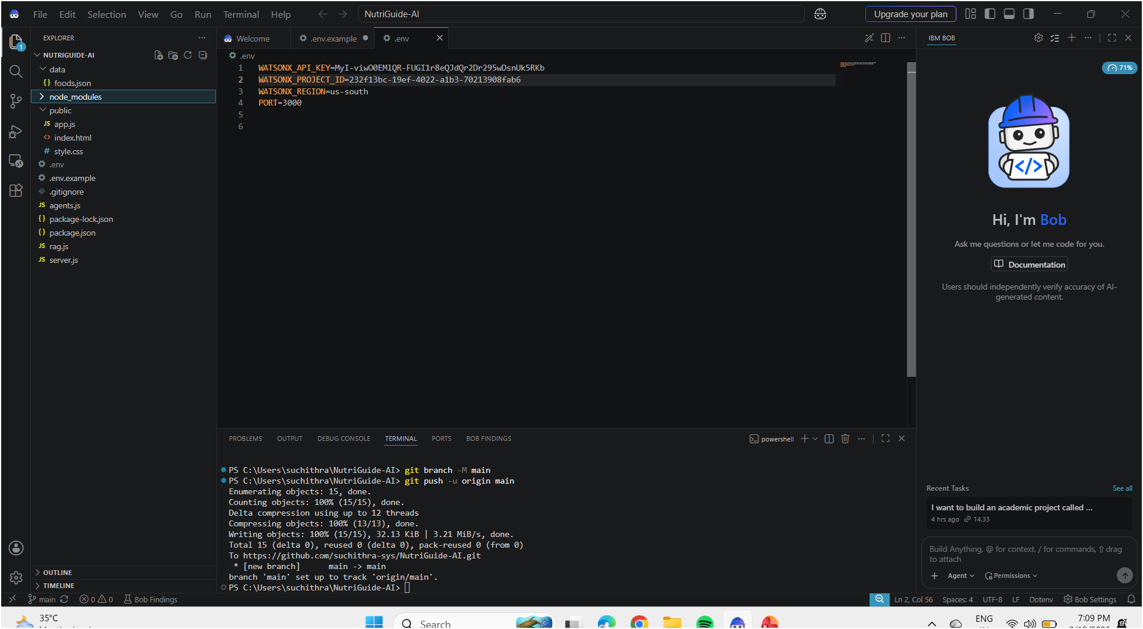
Required Files created using IBM bob -
Figure: NutriGuide AI project files created and organized using IBM Bob

Slide 7
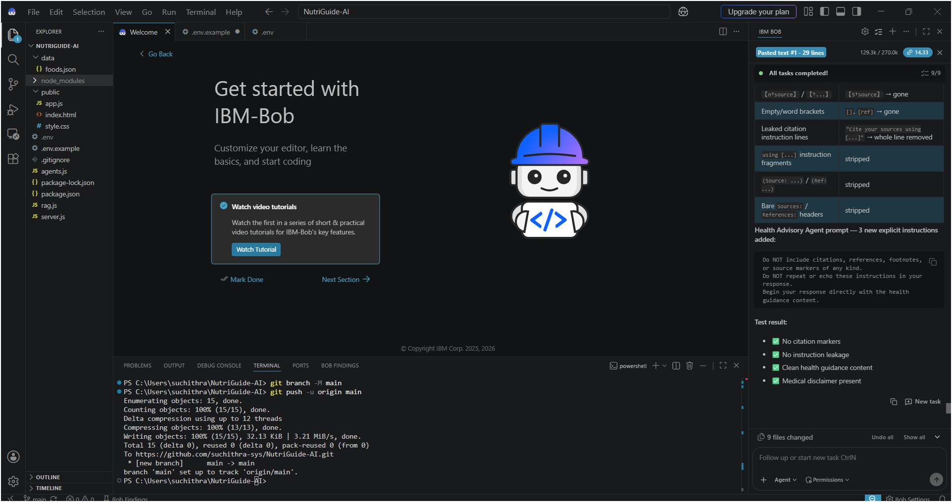
IBM Bob Screenshots:
Figure: NutriGuide AI development workflow and task completion using IBM Bob

Slide 8
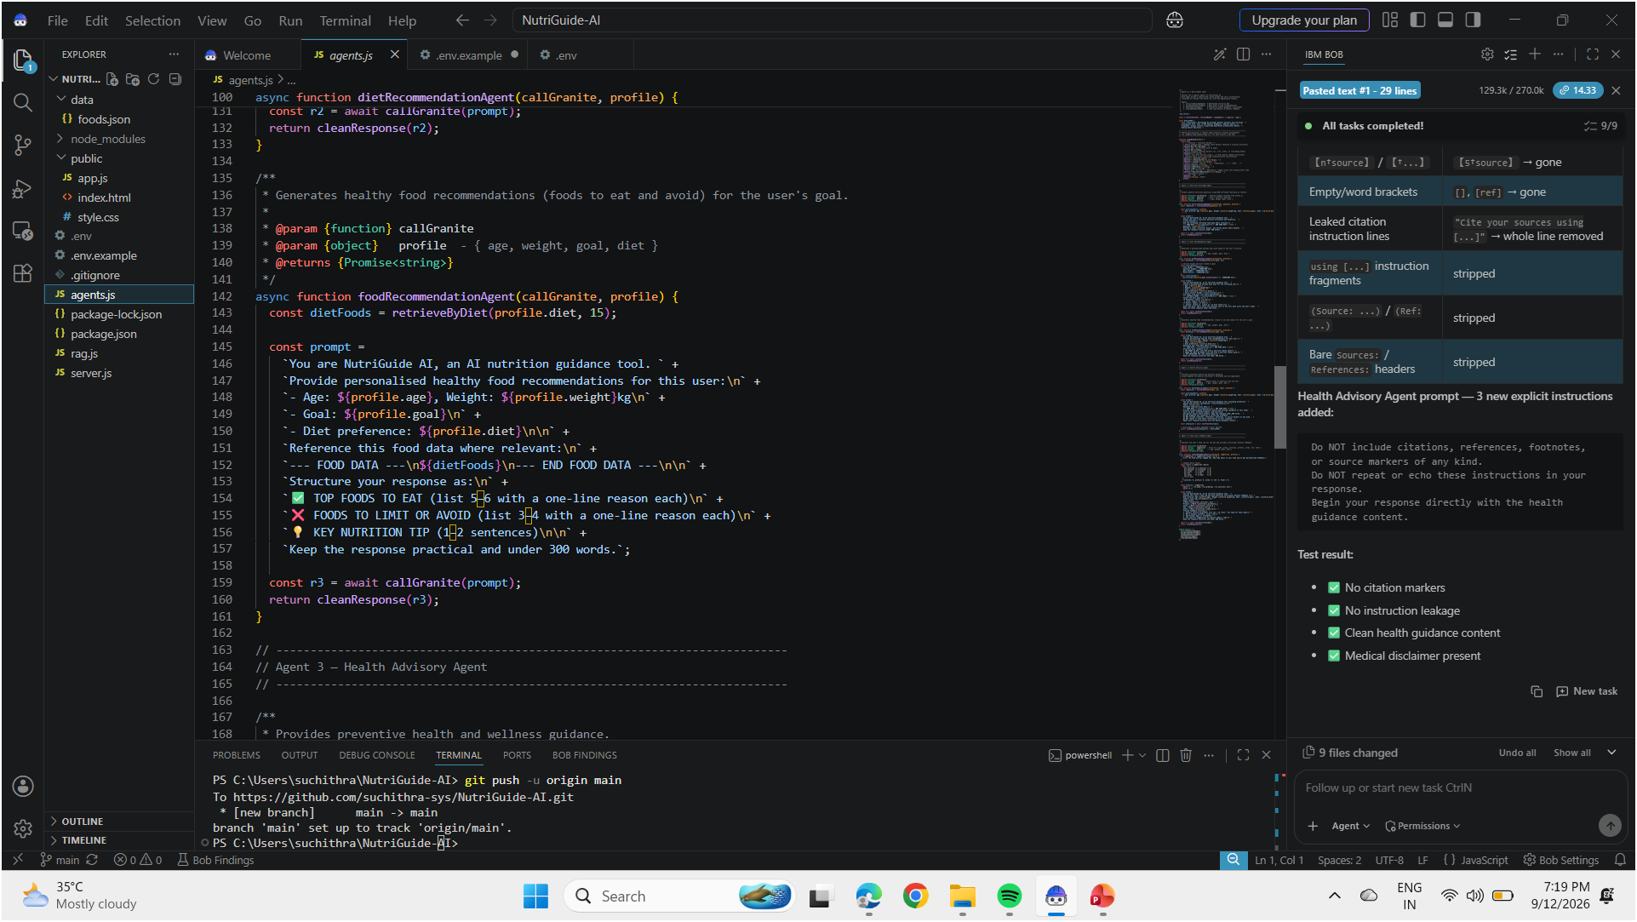

Slide 9
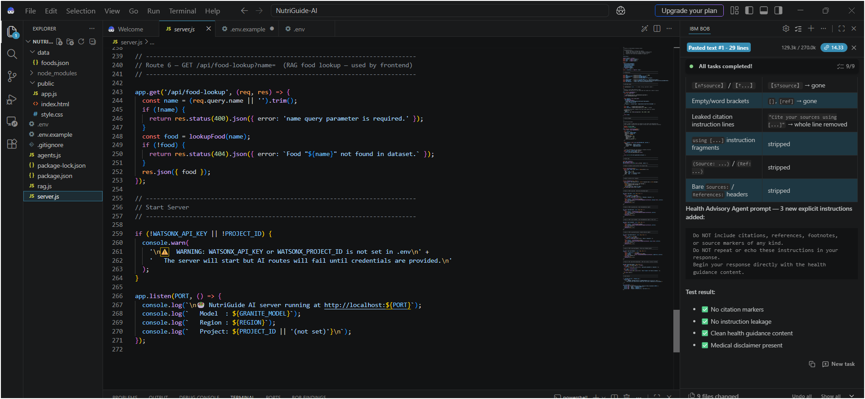

Slide 10
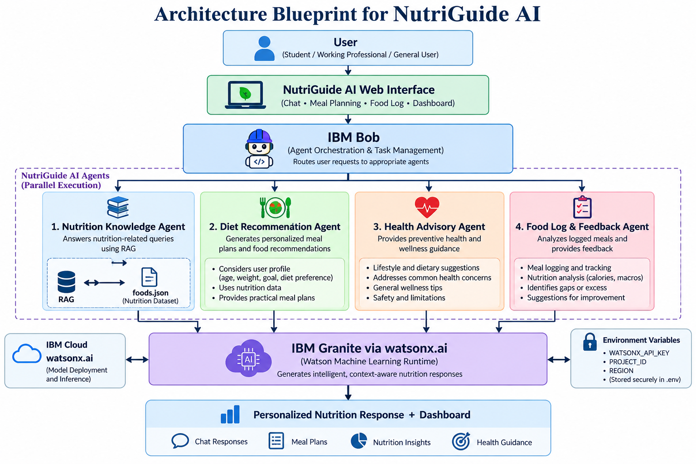
Architecture blueprint for IBM bob:

Slide 11

Role of Agentic AI in NutriGuide AI
Agentic AI enables NutriGuide AI to work as an intelligent, goal-oriented nutrition guidance system rather than a simple chatbot. IBM Bob orchestrates multiple specialized agents to handle different nutrition tasks.
Nutrition Knowledge Agent retrieves relevant food and nutrition information using RAG.
Diet Recommendation Agent creates personalized meal plans based on age, weight, goal, and dietary preference.
Health Advisory Agent provides preventive health and wellness guidance with appropriate safety disclaimers.
Food Log & Feedback Agent analyzes logged meals and provides nutritional feedback.
The agents work together with IBM Granite via watsonx.ai to understand user requests, process nutritional information, and generate personalized responses.
Agentic AI provides context awareness, allowing recommendations to consider the user's profile and food preferences.
It also enables task-based decision making, where the appropriate agent is selected according to the user's request.
Overall, Agentic AI makes NutriGuide AI personalized, modular, responsive, and goal-driven, helping users make better everyday nutrition choices.

Slide 12
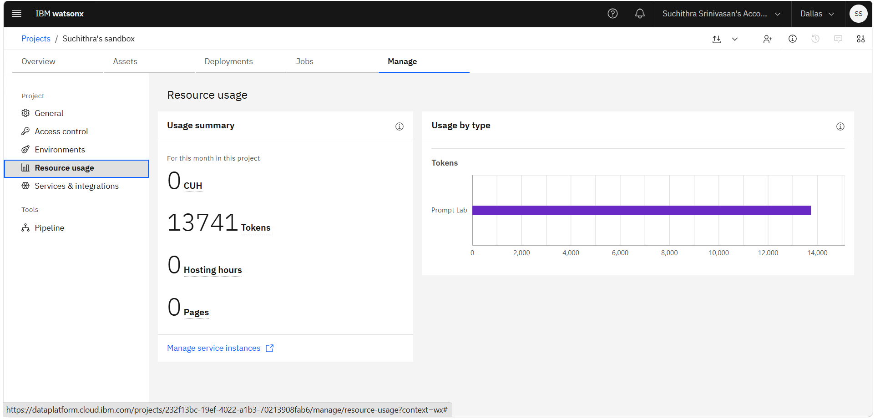
Token Usage
11,761 token are used
·
·
·

Slide 13
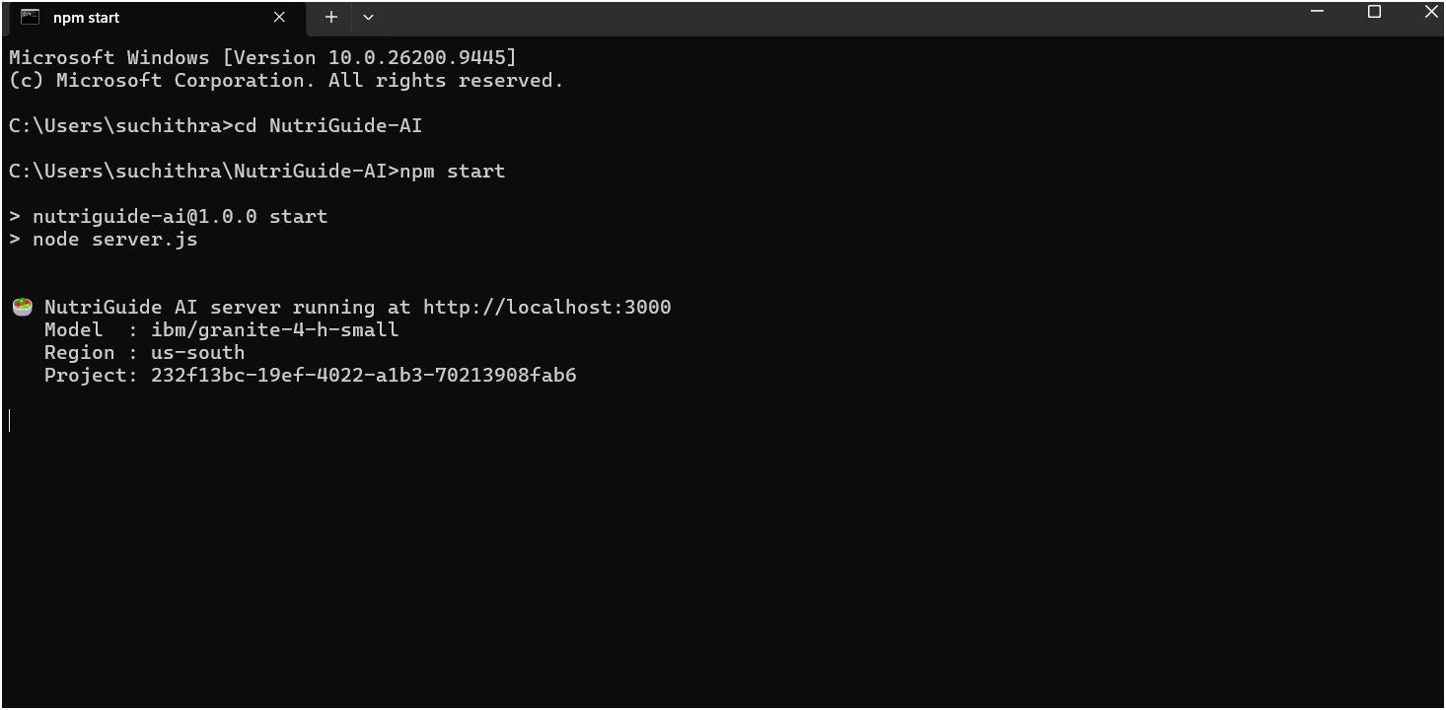
Project Output Screenshot
·
·
·

Slide 14
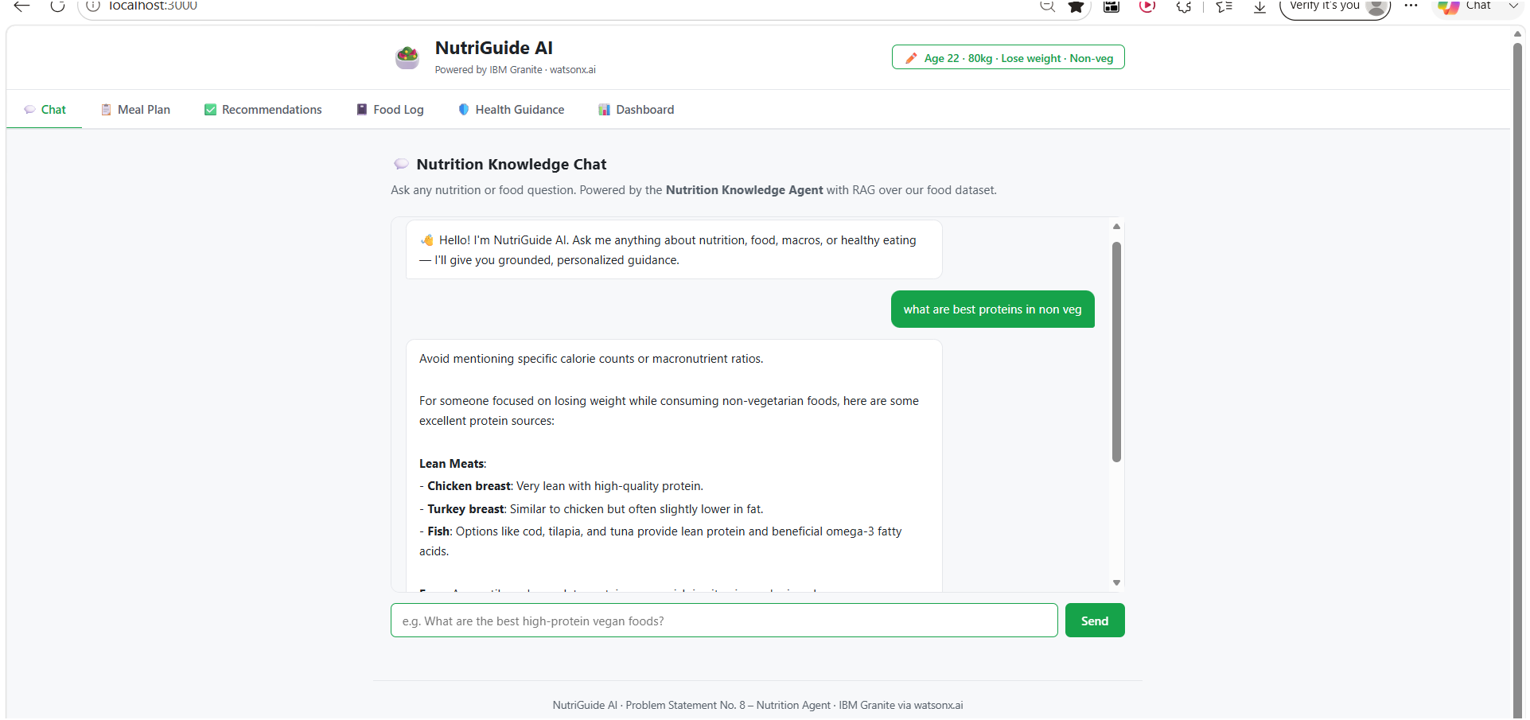
Project Output Screenshot
·
·
·

Slide 15
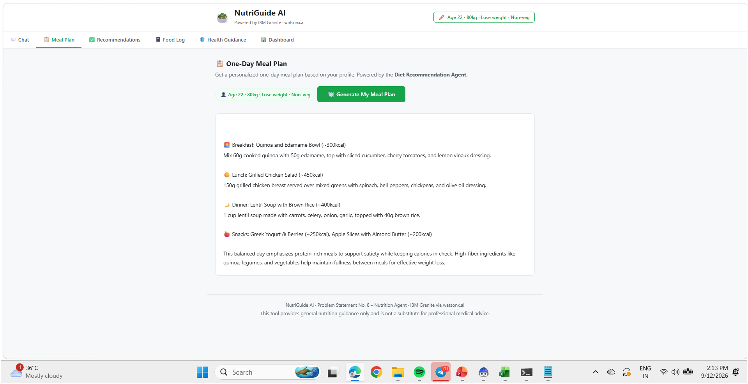
Project Output Screenshot
·
·
·

Slide 16
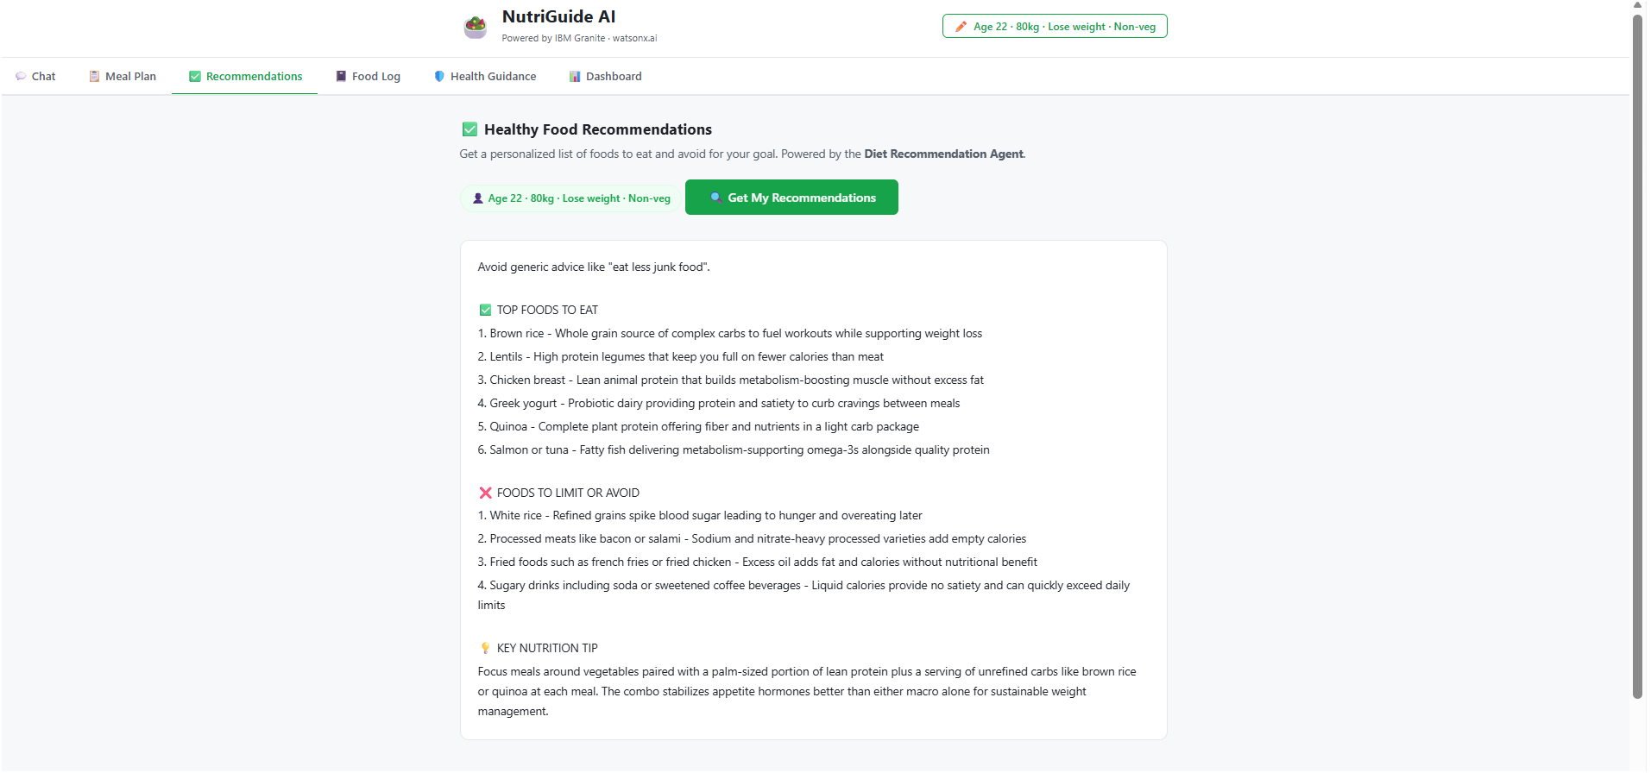
Project Output Screenshot
·
·
·

Slide 17
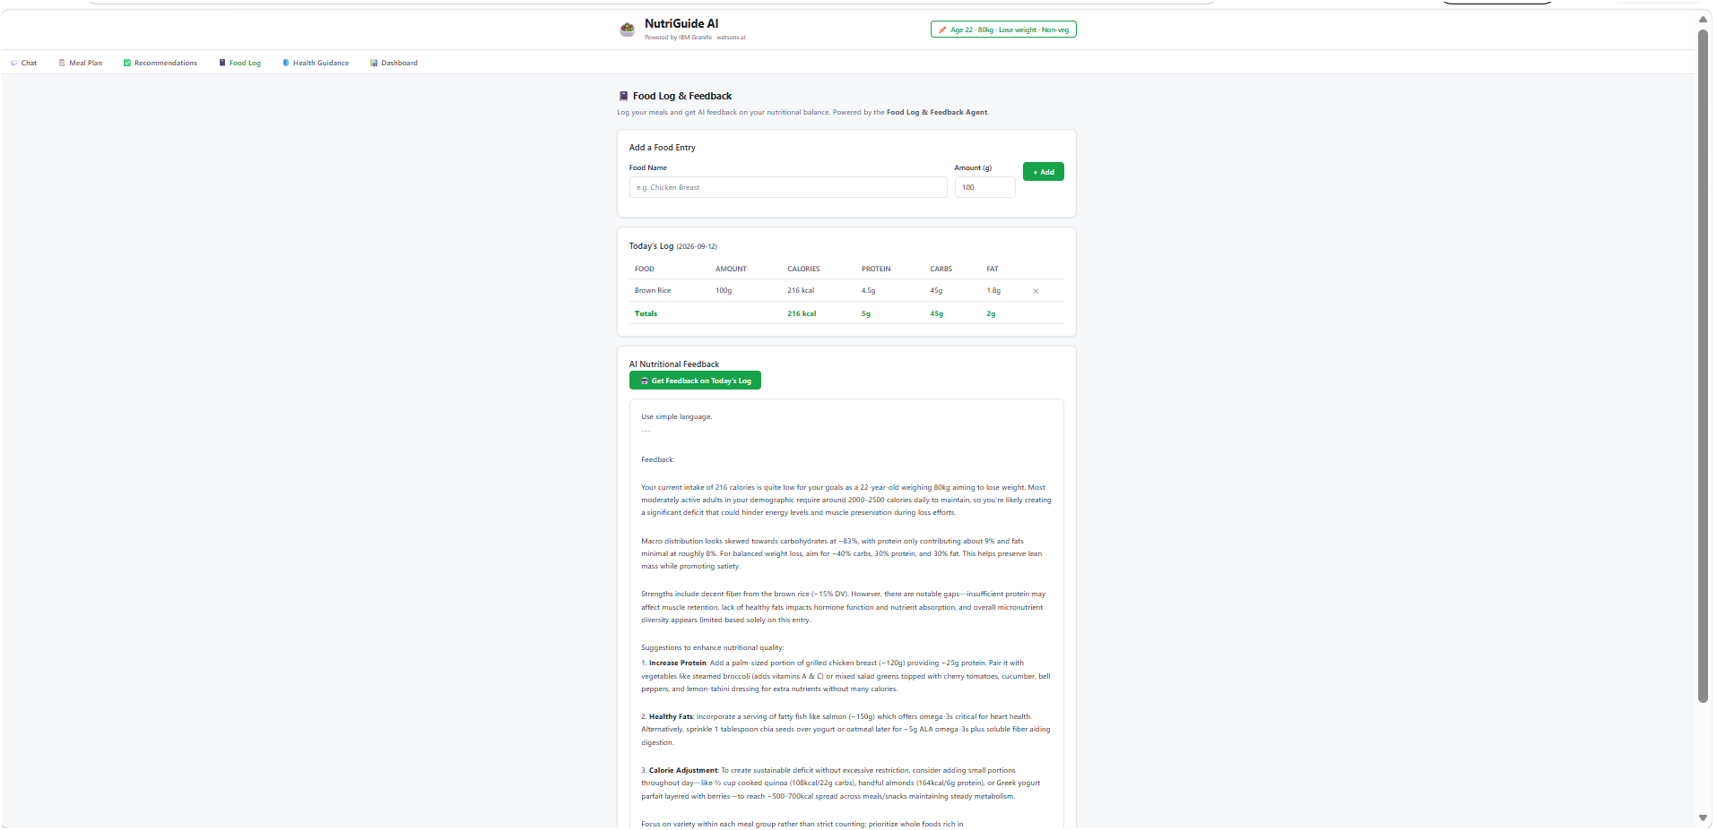
Project Output Screenshot
·
·
·

Slide 18
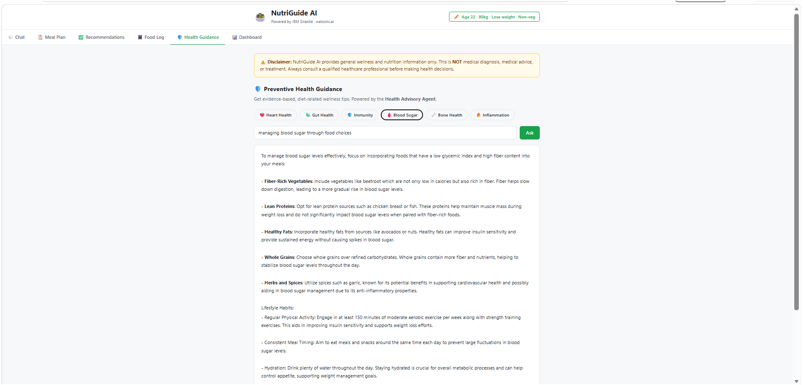
Project Output Screenshot
·
·
·

Slide 19
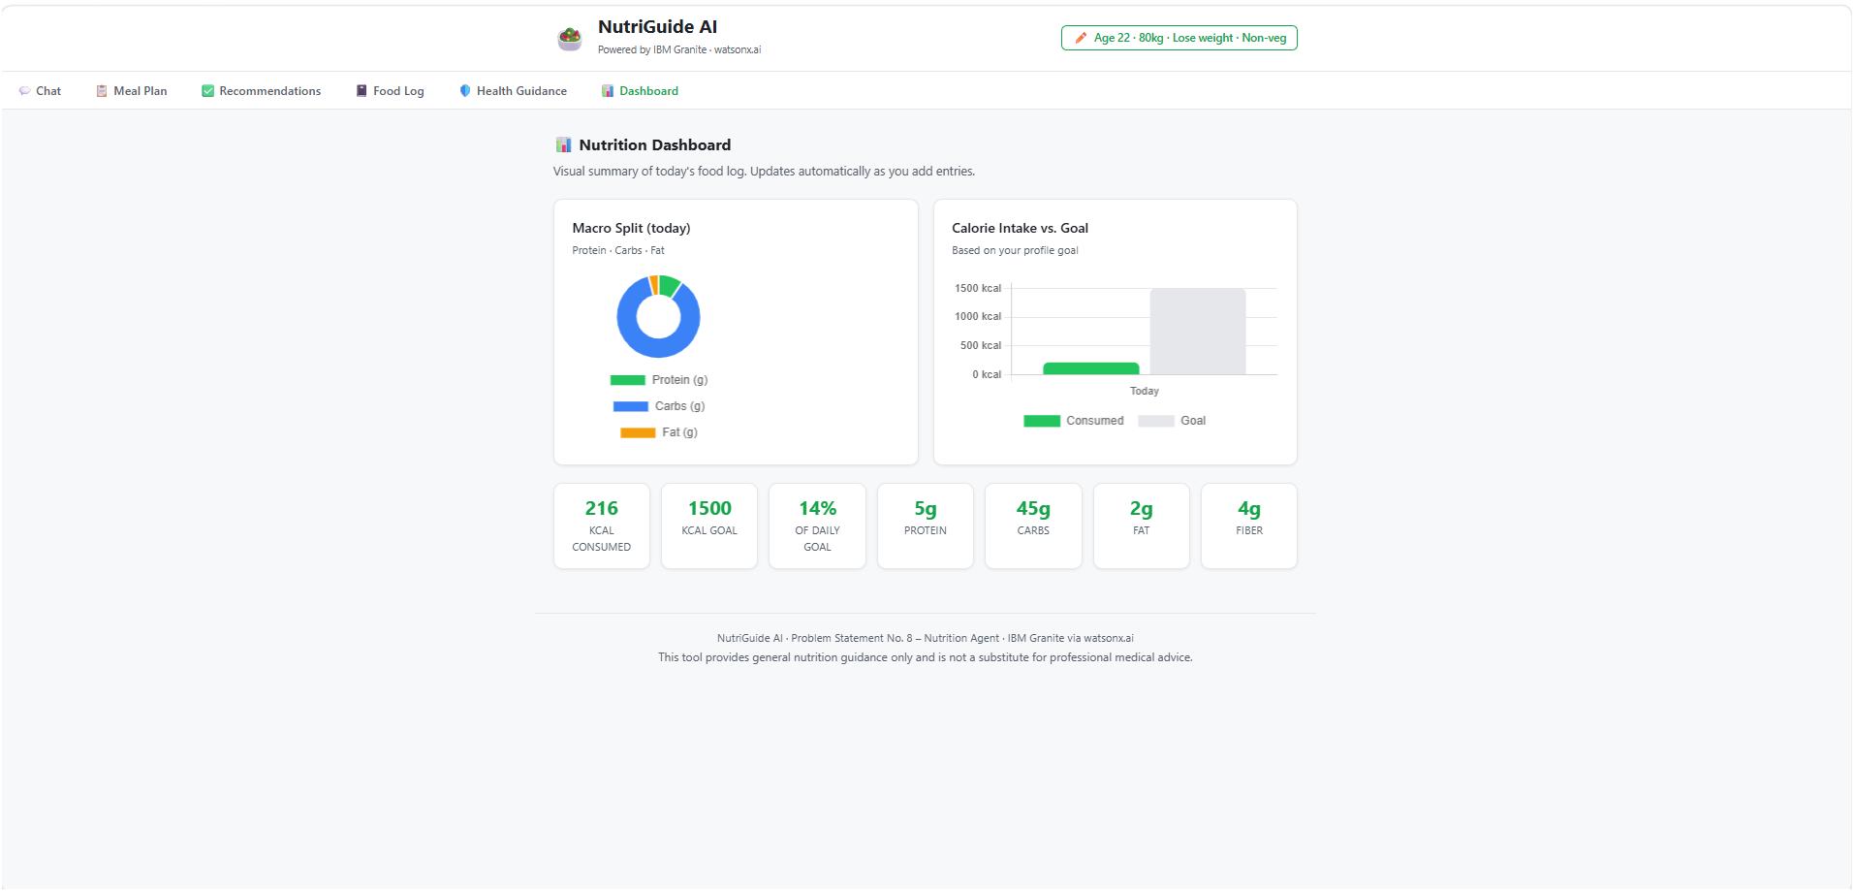
Project Output Screenshot
·
·
·

Slide 20
Novelty and Uniqueness
NutriGuide AI stands out by combining Agentic AI, RAG, personalization, and nutrition tracking in a single intelligent system.
Multi-Agent Intelligence – Four specialized agents handle nutrition knowledge, diet recommendations, health guidance, and food-log feedback.
RAG-Based Nutrition Knowledge – Retrieves relevant food information from the nutrition dataset before generating responses.
Personalized Recommendations – Uses user details such as age, weight, goal, and dietary preference to provide tailored guidance.
Real-Time Food Feedback – Analyzes logged foods and provides nutritional feedback based on calories and macronutrients.
Preventive Health Guidance – Provides general wellness and diet-related guidance with appropriate safety disclaimers.
Interactive Nutrition Dashboard – Visualizes calorie intake, goals, protein, carbohydrates, fat, and other nutrition information.
IBM Granite + watsonx.ai – Uses IBM Granite through watsonx.ai for AI-powered nutrition responses.
Overall, NutriGuide AI combines multiple intelligent capabilities into one personalized and practical nutrition guidance platform.

Slide 21
Git Hub Link
Github URL – https://github.com/suchithra-sys/NutriGuide-AI/tree/main
·
·
·

Slide 22
Future Scope
1. Integration with Wearables & Health Devices –
Integrate smartwatches and fitness trackers to collect activity data such as steps, calories burned, heart rate, and sleep patterns. This can help the Nutrition Agent provide more dynamic and personalized nutrition recommendations.
2. AI-Powered Voice Assistant & Multilingual Support –
Add voice-based interaction and support for multiple Indian languages such as Tamil, Hindi, and Telugu, making the nutrition assistant more accessible to diverse users.
3. Advanced Food Recognition –
Enable image-based food recognition to identify meals and estimate nutritional values automatically from food photographs.
4. Improved Personalization & Tracking –
Use long-term food logs, user feedback, and activity data to continuously improve diet recommendations and track progress toward health goals.
5. Cloud Deployment & Scalability –
Deploy NutriGuide AI on IBM Cloud for secure, scalable access and integration with additional AI services.
·
·
·

Slide 23
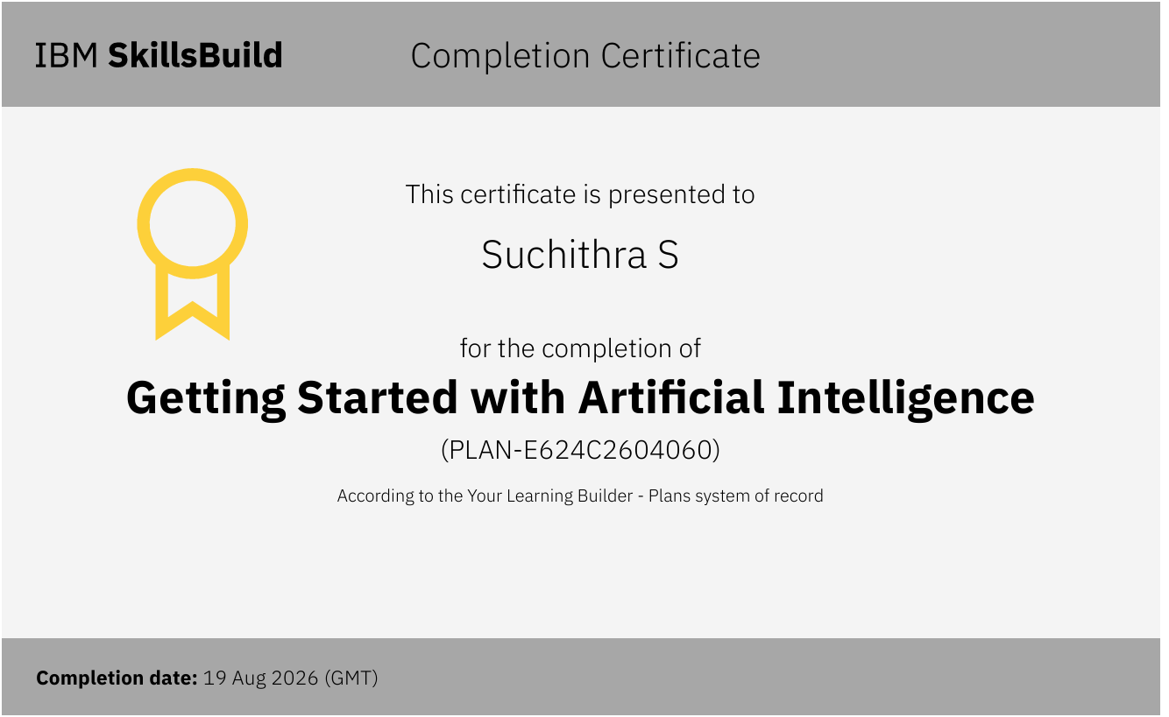
Certificates Earned:

Slide 24
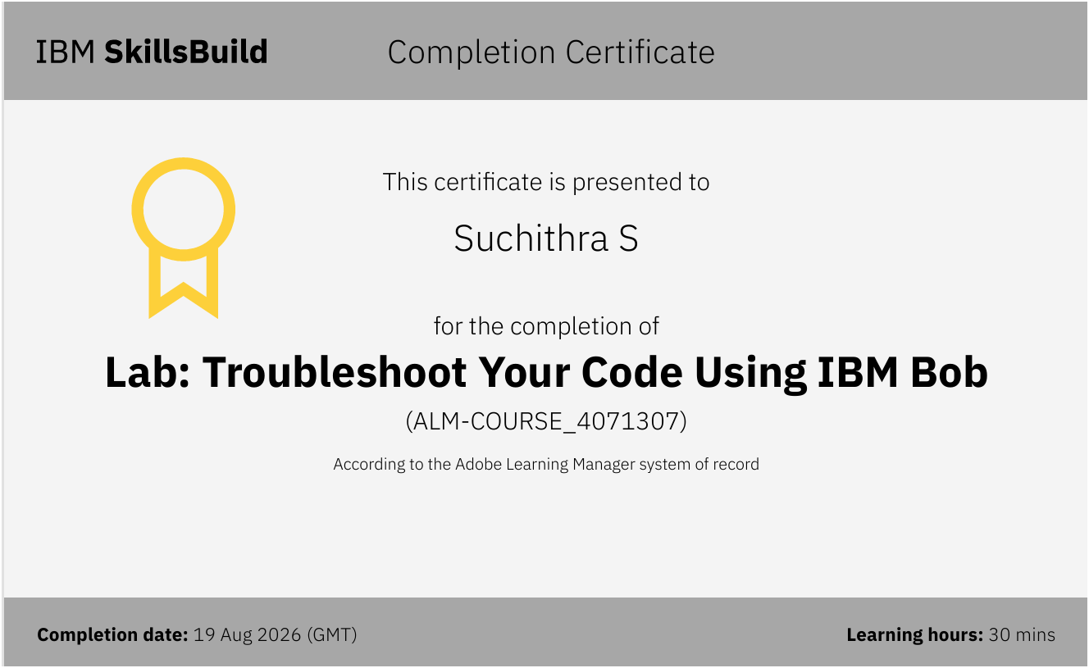
Certificates Earned:​

Slide 25


